Slide 1
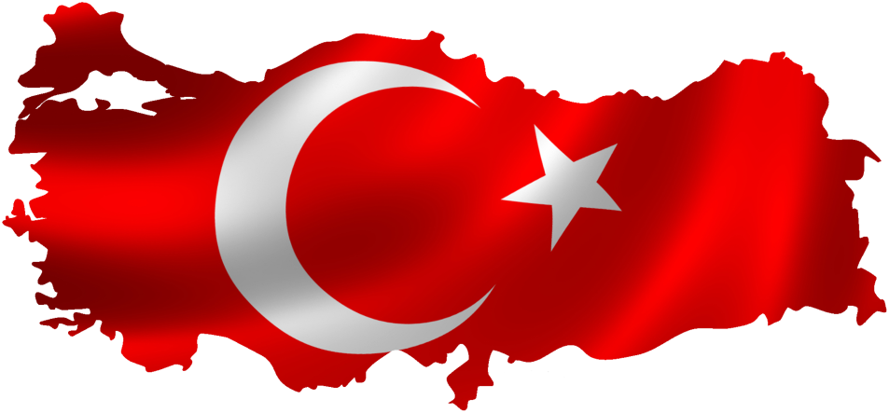
Namık Karamancı Science High School

Slide 2
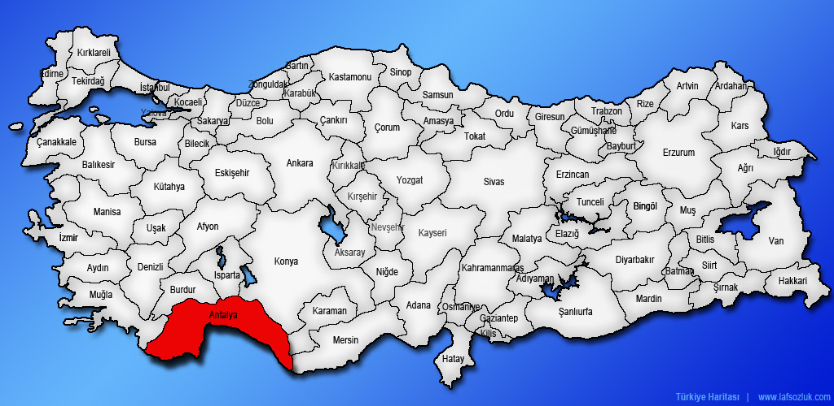
Namık Karamancı Science High School

Slide 3
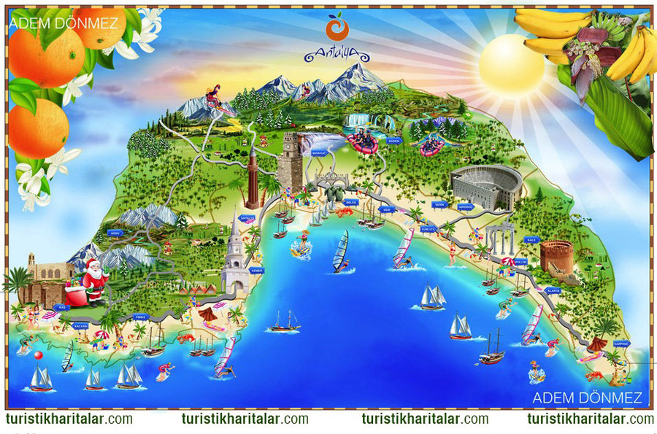
Namık Karamancı Science High School
Touristic map of Antalya

Slide 4
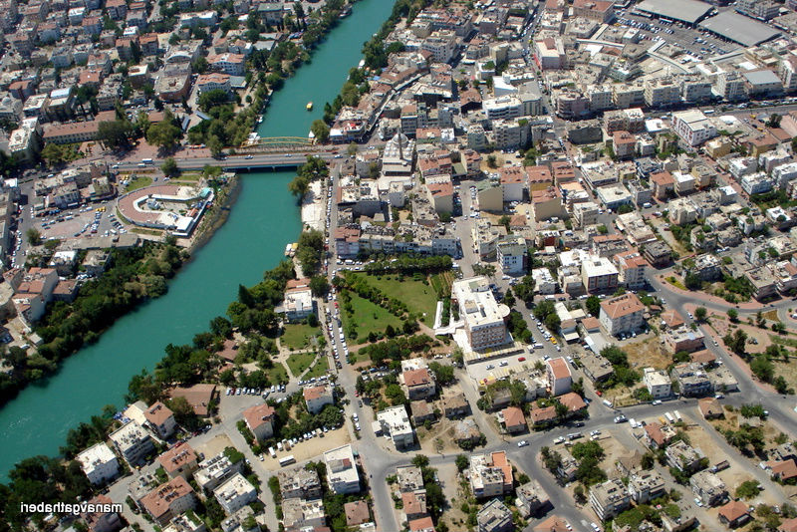
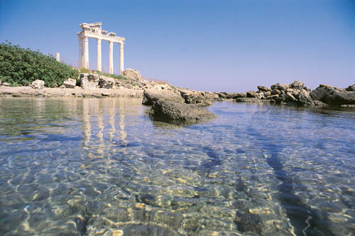
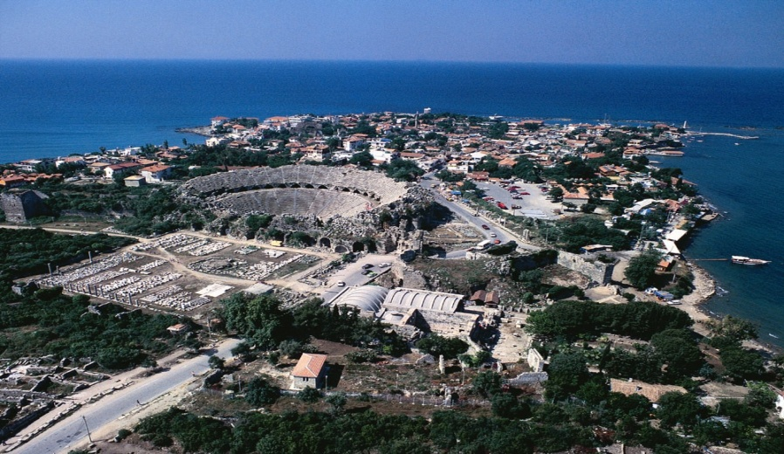
Namık Karamancı Science High School
Manavgat

Slide 5
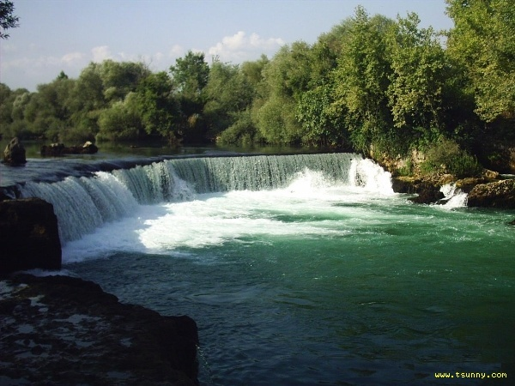
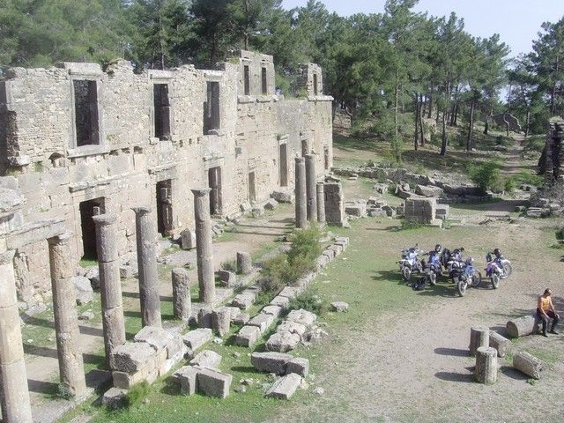
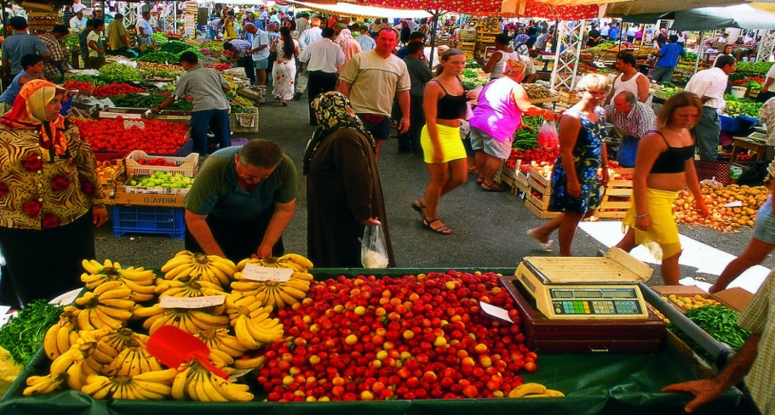
Namık Karamancı Science High School
Manavgat

Slide 6
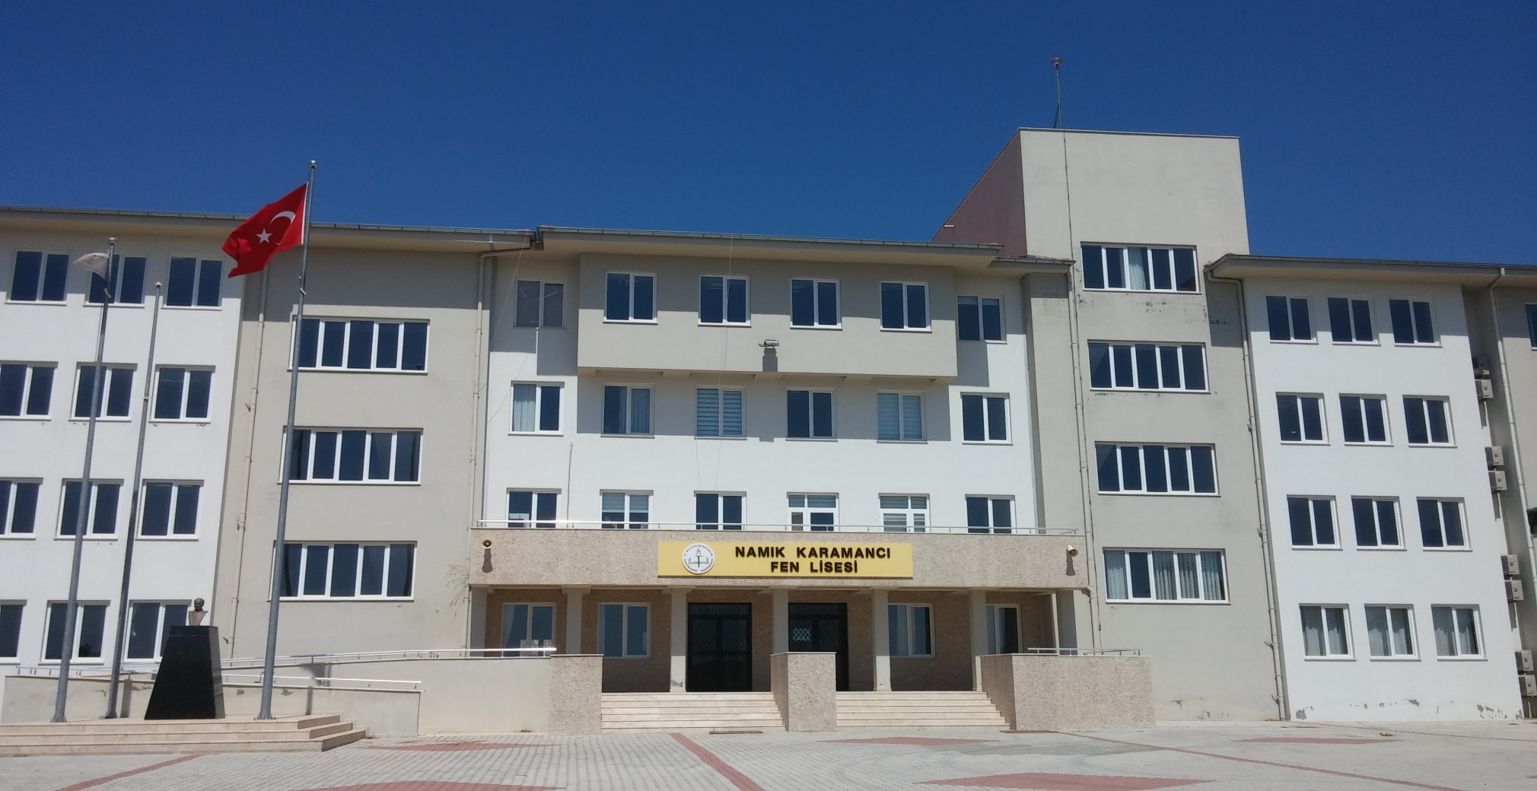
Namık Karamancı Science High School
Warm greetings…

Slide 7
Namık Karamancı Science High School
some facts about our school;
established in 2011
500 students (14-18) and 35 teachers
200 students stay at the dormitory
intensive maths, chemistry, physics and biology education as well as Turkish, English, German, history, geography and etc…

Slide 8
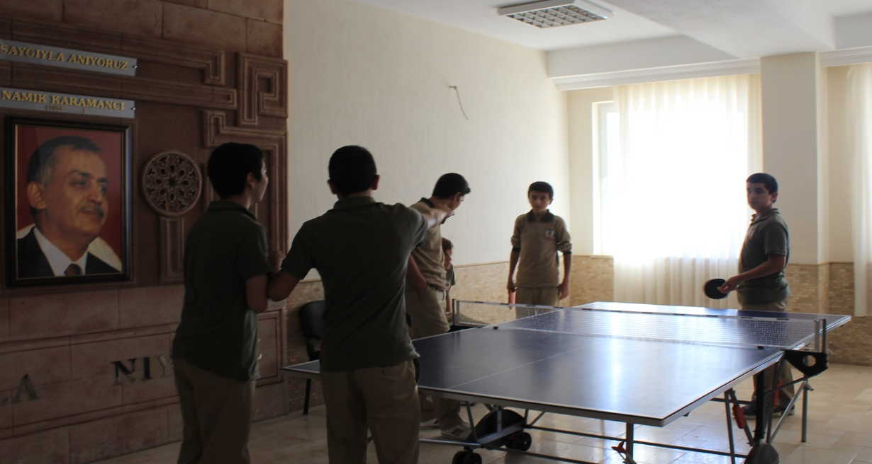
Namık Karamancı Science High School

Slide 9
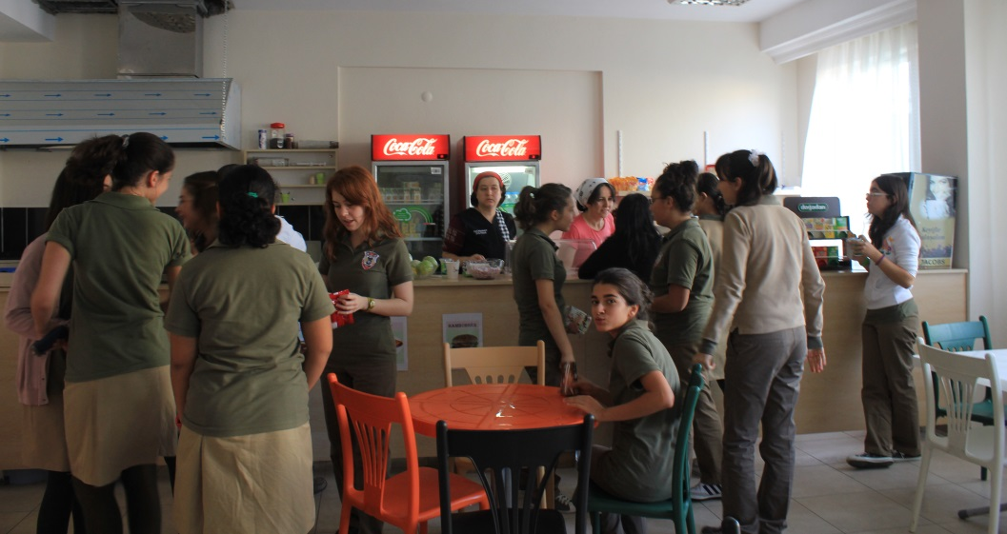
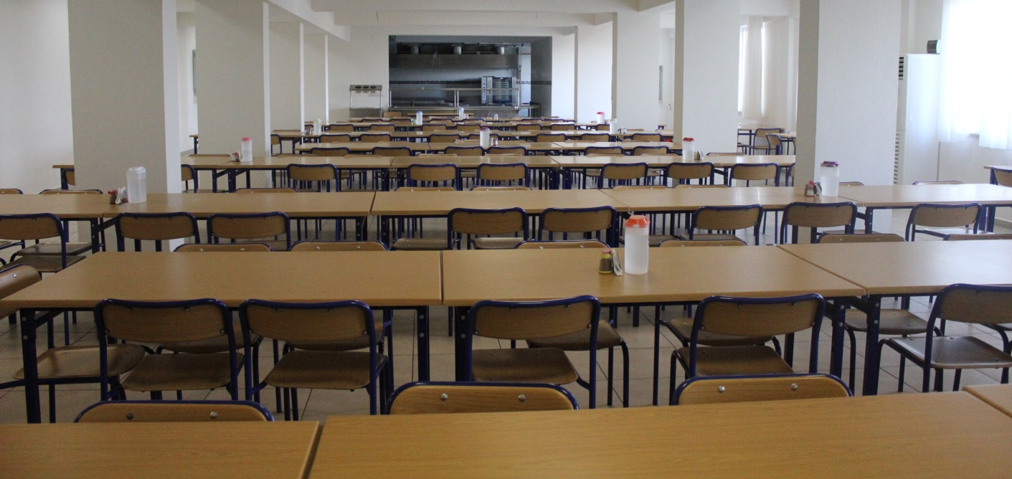
Namık Karamancı Science High School

Slide 10
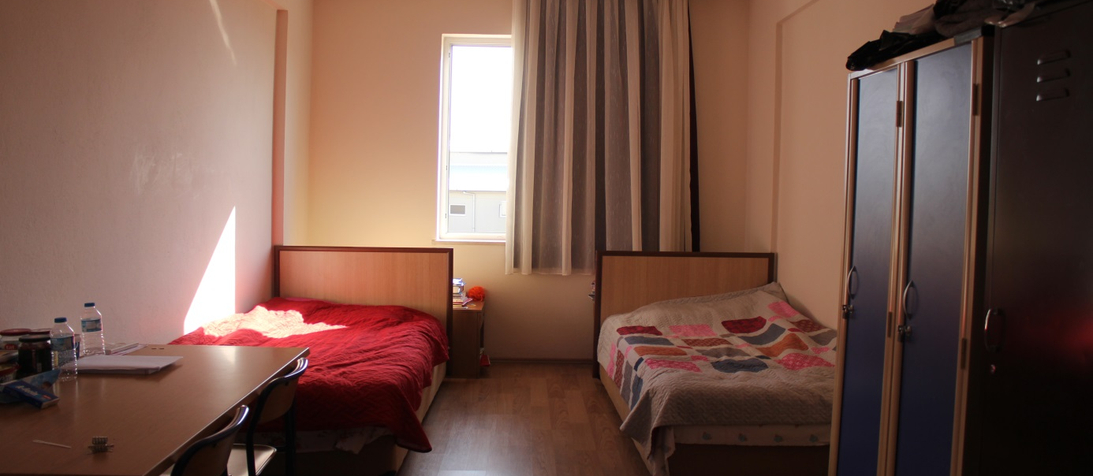
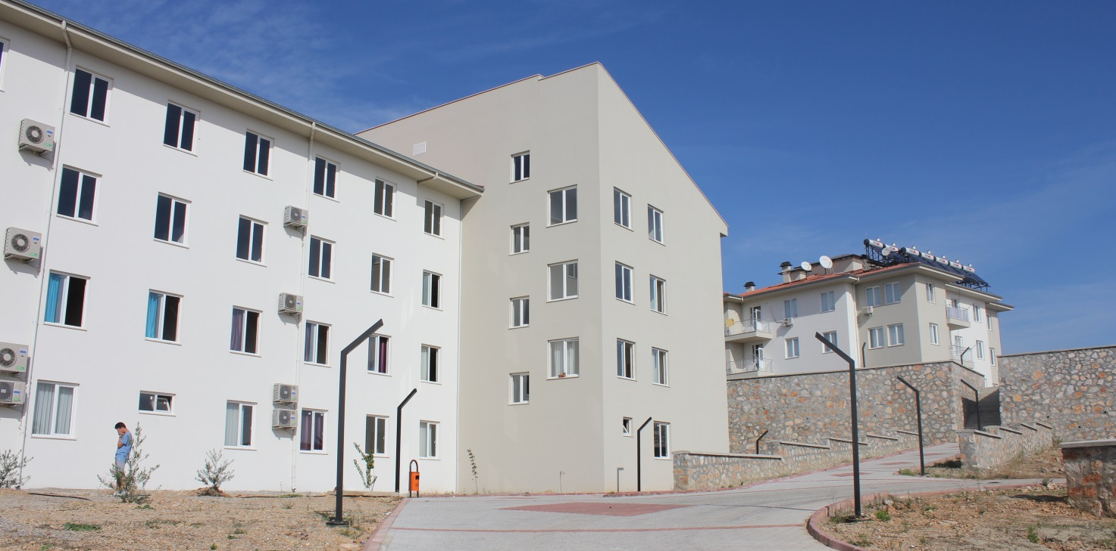
Namık Karamancı Science High School

Slide 11
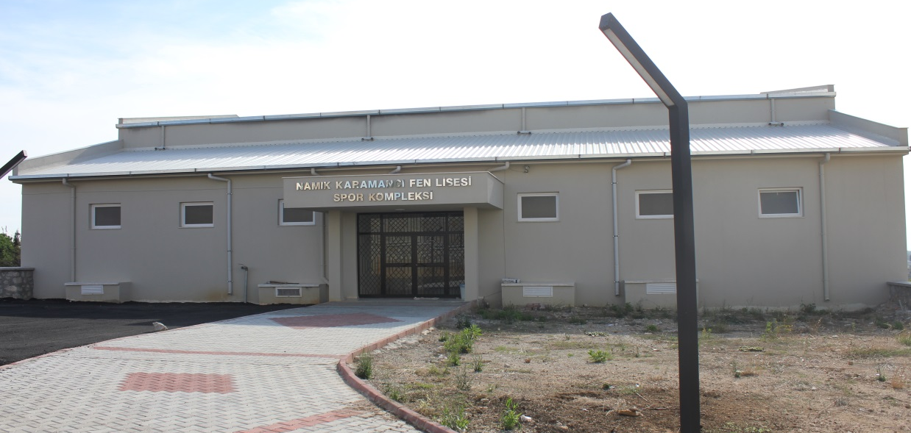
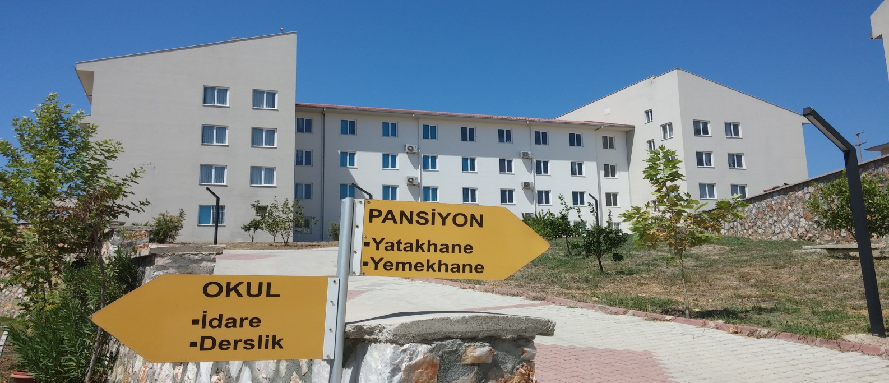
Namık Karamancı Science High School

Slide 12
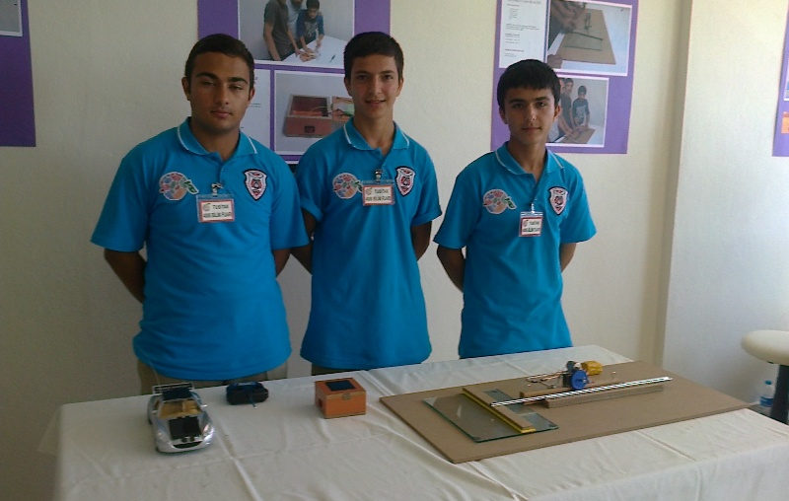
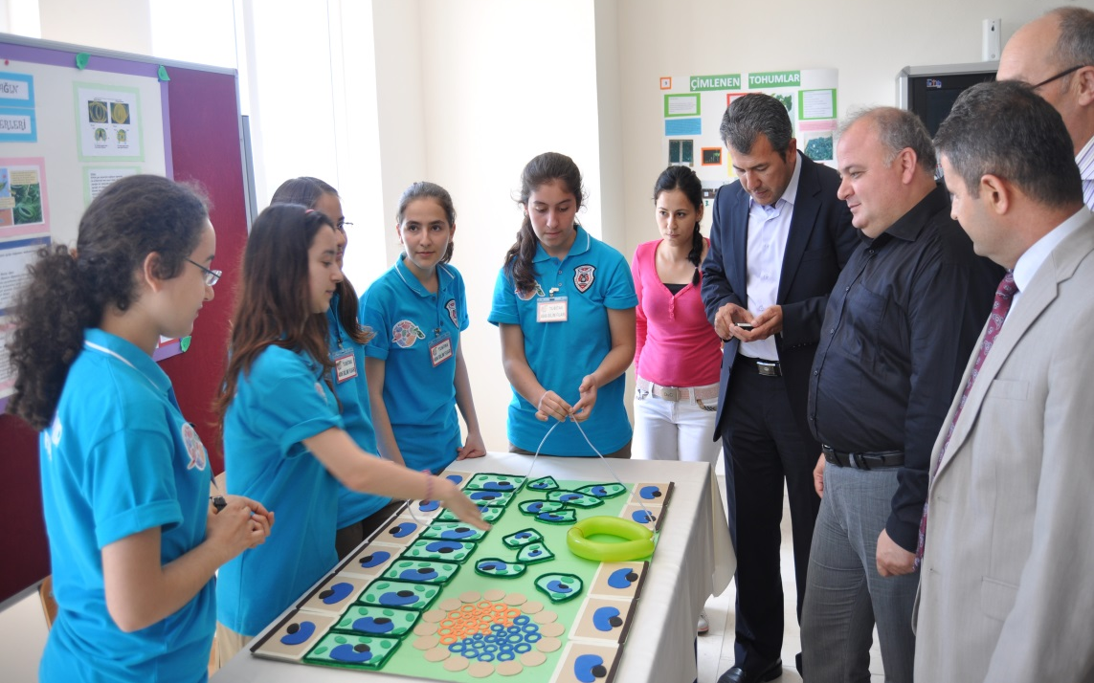
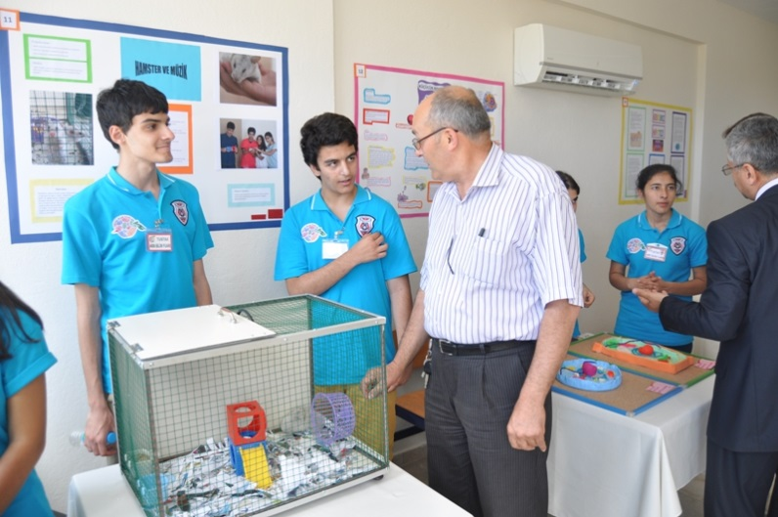
Namık Karamancı Science High School

Slide 13
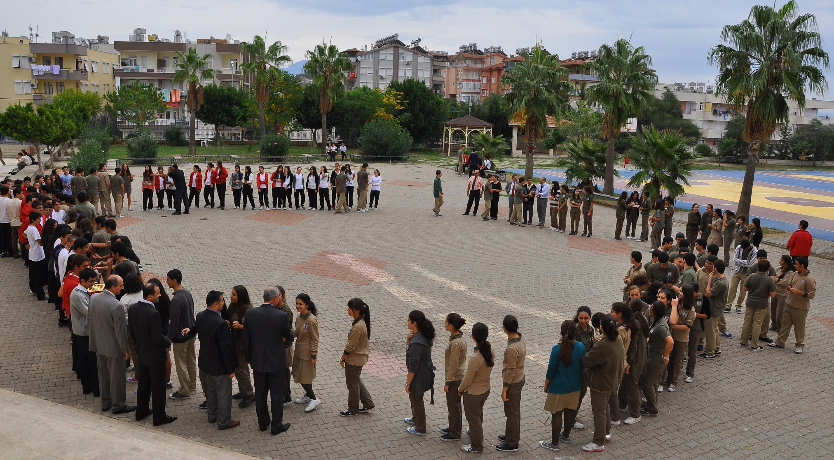
Namık Karamancı Science High School

Slide 14
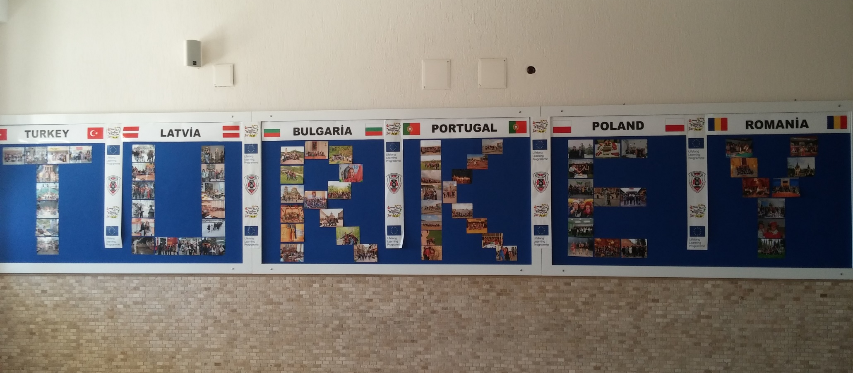
Namık Karamancı Science High School

Slide 15
Namık Karamancı Science High School
international projects;
we hosted a Comenius assistant from Poland in 2013-2014 education year
we implemented a Comenius partnership named ‘Healthy and Active Teeneagers; the Future of Europe’ with partners from Latvia, Poland, Portugal, Romania and Bulgaria from 2013-2015.

Slide 16
Namık Karamancı Science High School
international projects;
We have finished 3 Erasmus+ KA2 projects:
1- Innovative Student-Teacher Evolution Model
2- Say NO to Indifference
3- Save Earth’s Life For Youth

Slide 17
Namık Karamancı Science High School
international projects;
We are running 4 Erasmus+ KA2 projects now;
1- ICT & ALT
2- Experiencing Cultural Diversity in Europe
3- Reversed Roles at School: Flipped Classroom
4- Be InteresTED

Slide 18
Namık Karamancı Science High School

